Slide 1
E-Commerce Sales Analysis
TOOLS | Microsoft Excel • Python

Slide 2
1. Executive Summary
This analysis evaluates e-commerce sales performance using order, customer, product, category, discount, and order-status data.
The objective was to identify revenue trends, understand category performance, evaluate customer and order activity, and identify areas where the business can improve revenue performance and operational efficiency.
02

Slide 3
2. Key Business KPIs
KPI | RESULT
Total Revenue | ₹24.04M
Total Orders | 1,000
Total Customers | 200
Average Order Value | ₹24,041.75
Return Rate | 7.40%
Cancellation Rate | 4.60%
Average Discount | 8.57%
03

Slide 4
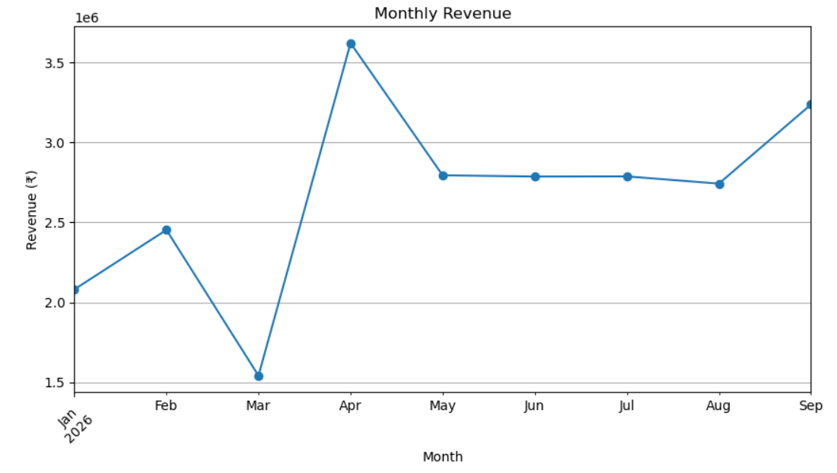
3. Revenue Trend Analysis
Key Insight
April recorded the highest monthly revenue at ₹3.62M, while March recorded the lowest at ₹1.54M.
Business Implication
The business should investigate what contributed to the strong performance in April and September and compare those periods with March.
04

Slide 5
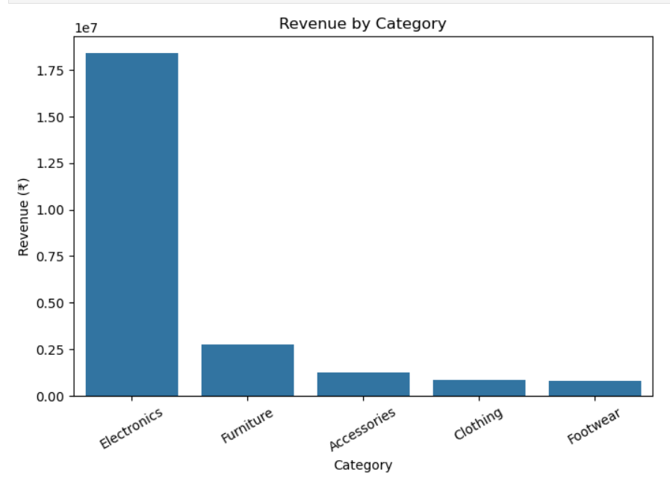
4. Category Performance
Key Insight
Electronics generated approximately ₹18.38M, representing about 76% of total revenue.
Business Implication
The company should closely monitor Electronics because changes in this category could have a significant effect on overall revenue.
05

Slide 6
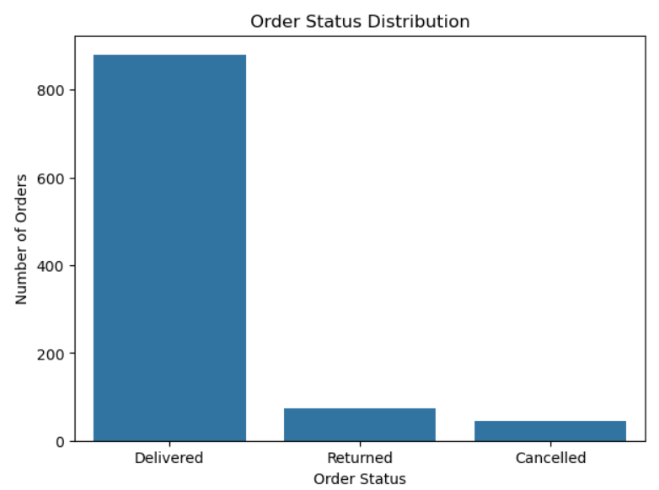
5. Order Status Analysis
Key Insight
The majority of orders were successfully delivered, with 88% of orders marked as Delivered.
However, 120 orders were either returned or cancelled.
Business Implication
Reducing avoidable returns and cancellations could improve operational efficiency and customer experience.
06

Slide 7

6. Customer Analysis
The dataset contains 200 unique customers and 1,000 orders, indicating an average of approximately 5 orders per customer across the analyzed period.
This provides an opportunity to understand customer purchasing behavior and identify high-value customers.
Recommended Customer Analysis
High-value and frequent customers can be targeted with:
Personalized offers
Loyalty programs
Product recommendations
Early access to promotions
Cross-selling opportunities
High-value customers
Frequent customers
Occasional customers
Low-engagement customers
07

Slide 8
7. Discount Analysis
The average discount across orders was 8.57%.
Discounts can help increase sales, but excessive discounting may reduce the revenue generated per order.
Recommendation
Instead of applying broad discounts across all products, the business should evaluate:
Which products require discounts to generate sales
Whether higher discounts actually increase order volume
Revenue generated before and after discounts
Discount performance by category
Customer response to different discount levels
This can help the business balance sales growth with revenue efficiency.
08

Slide 9
8. Key Business Insights
Insight 1 — Electronics is the main revenue driver
Electronics generated ₹18.38M, approximately 76% of total revenue.
Insight 2 — Revenue varies significantly by month
April generated ₹3.62M, while March generated only ₹1.54M.
Insight 3 — Returns require attention
The return rate was 7.40%. Identify the products and categories contributing most to returns and investigate their underlying causes.
Insight 4 — Cancellations represent an improvement opportunity
The cancellation rate was 4.60%. Analyze cancellation patterns to identify whether pricing, availability, or fulfillment issues are contributing.
Insight 5 — Discounts should be optimized
The average discount was 8.57%. Evaluate discount effectiveness instead of relying on discounts uniformly across products.
09

Slide 10
9. Business Recommendations
Strengthen Electronics Performance
Since Electronics contributes approximately 76% of revenue, the business should prioritize inventory planning, product availability, and customer retention within this category.
Reduce Product Returns
Analyze returned orders at product and category level to identify recurring issues and take corrective action.
Optimize Discount Strategy
Use historical sales data to determine which discount levels generate additional demand and avoid unnecessary discounting where customers are likely to purchase without incentives.
Investigate the March Revenue Decline
March had the lowest monthly revenue. Management should compare March with high-performing months to identify differences in product demand, availability, pricing, and marketing activity.
Reduce Avoidable Cancellations
Investigate cancellation reasons and identify whether stock availability, delivery timelines, or pricing are contributing to cancelled orders.
Develop Customer Segmentation
Identify high-value and frequent customers and create targeted retention strategies such as loyalty benefits, personalized recommendations, and relevant offers.
10

Slide 11
Project Conclusion
The analysis shows that the business generated ₹24.04M in revenue from 1,000 orders and 200 customers.
The most important finding is the strong contribution of the Electronics category, which generated approximately 76% of total revenue. Revenue also varied considerably across months, with April being the strongest month and March the weakest.
While the majority of orders were successfully delivered, the 7.40% return rate and 4.60% cancellation rate represent areas where further investigation could improve operational efficiency and customer experience.
Overall, the recommended focus areas are protecting Electronics revenue, understanding monthly sales fluctuations, reducing returns and cancellations, optimizing discounts, and strengthening customer retention.

